Slide 1


Department of Computer Science
University Institute of Engineering
DEPARTMENT OF COMPUTER SCIENCE & ENGINEERING
Bachelor of Engineering
Subject Name: System Programming
Subject Code: CST-315
Compilers
DISCOVER . LEARN . EMPOWER

Slide 2
Chapter-3.1 Linkers and Loaders
Department of computer Science
Introduction to Linker
Relocation of Linking Concept
Self Relocating Program

Slide 3
Linker
Linker is a program in a system which helps to link object modules of a program into a single object file.
It performs the process of linking. Linkers are also called as link editors. Linking is a process of collecting and maintaining piece of code and data into a single file.
Linker also links a particular module into system library. It takes object modules from assembler as input and forms an executable file as output for the loader.
Linking is performed at both compile time, when the source code is translated into machine code and load time, when the program is loaded into memory by the loader. Linking is performed at the last step in compiling a program.
Source code -> compiler -> Assembler -> Object code -> Linker -> Executable file -> Loader

Slide 4
Types of Linking
Linking is of two types:
1. Static Linking – It is performed during the compilation of source program. Linking is performed before execution in static linking. It takes collection of relocatable object file and command-line arguments and generates a fully linked object file that can be loaded and run. Static linker performs two major tasks
The process is repeated until the program is mistake free and translated to an object code.
Symbol resolution – It associates each symbol reference with exactly one symbol definition .Every symbol has a predefined task.
Relocation – It relocates code and data section and modifies the symbol references to the relocated memory locations.
The linker copies all library routines used in the program into executable image. As a result, it requires more memory space. As it does not require the presence of library on the system when it is run, so it is faster and more portable. No failure chance and less error chance.

Slide 5
Dynamic Linking:
2. Dynamic linking – Dynamic linking is performed during the run time. This linking is accomplished by placing the name of a shareable library in the executable image.
There are more chances of errors and failures. It require less memory space as multiple programs can share a single copy of the library. Here we can perform code sharing.
It means if we are using the same object a number of times in the program, instead of linking the same object again and again into the library, each module shares information of the object with other modules having the same object.
The shared library needed in the linking is stored in virtual memory to save RAM. In this linking we can also relocate the code for the smooth running of code but all the code is not relocatable. It fixes the address at run time.

Slide 6
Relocation of linking concept
Program relocation is the process of modifying the addresses used in the address sensitive instruction of a program such that the program can execute correctly from the designated area of memory.
If linked origin≠ translated origin, relocation must be performed by the linker.
If load origin≠ linked origin, relocation must be performed by the loader.

Slide 7
Let AA be the set of absolute address - instruction or data addresses used in the instruction of a program P.
AA≠ ф implies that program P assumes its instructions and data to occupy memory words with specific addresses.
Such a program – called an address sensitive program – contains one or more of the following:
An address sensitive instruction: an instruction which uses an address a ∈ AA.
An address constant: a data word which contains an address a ∈ AA.
An address sensitive program P can execute correctly only if the start address of the memory area allocated to it is the same as its translated origin.
To execute correctly from any other memory area, the address used in each address sensitive instruction of P must be ‘corrected’.

Slide 8
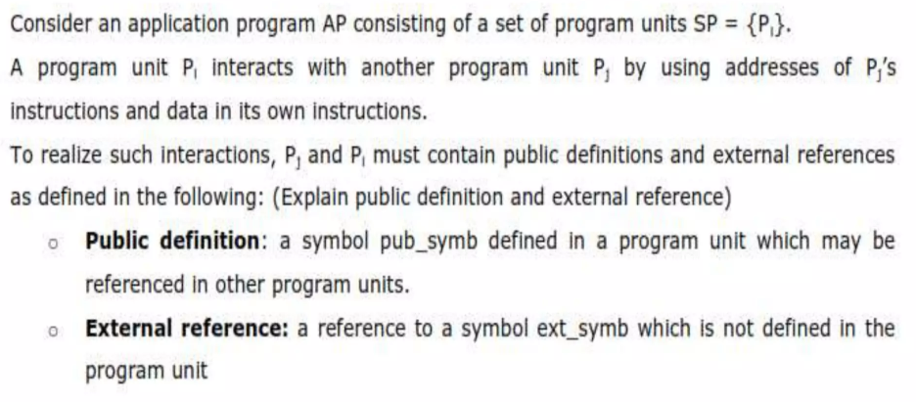
Performing Linking

Slide 9
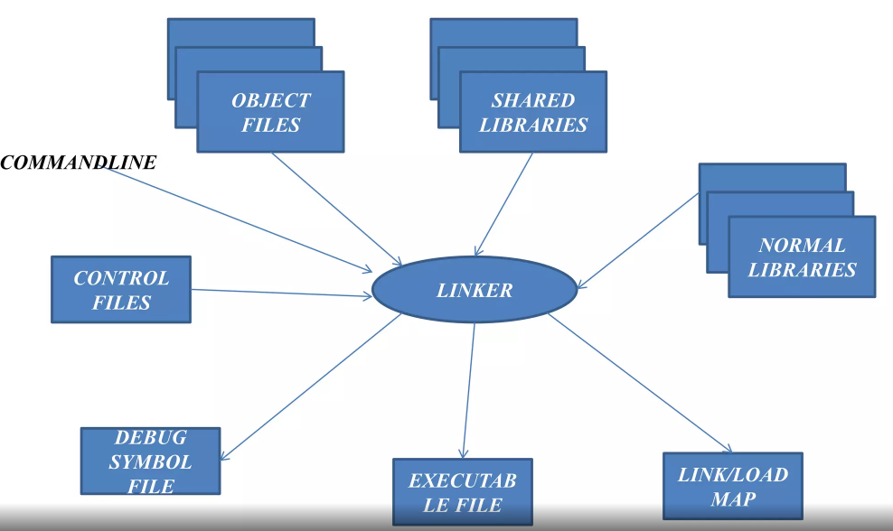
LINKING

Slide 10
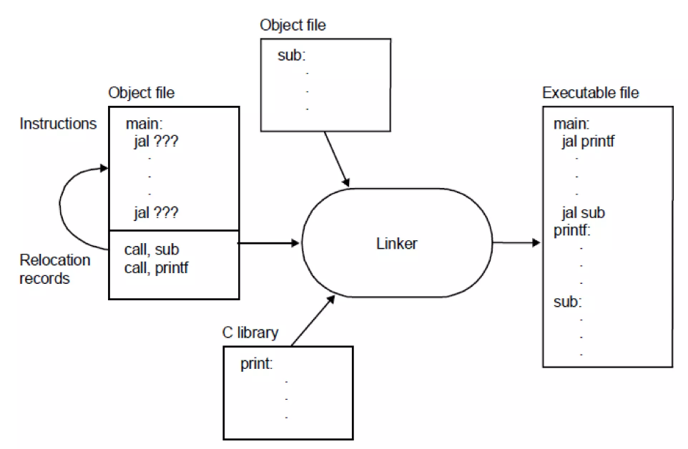

Slide 11
Self-Relocating Program
A self-relocating program is one that relocates its address-sensitive instructions to other parts of the memory. The program performs its own relocation and does not require a linker. Self-relocation is used in time-sharing operating systems where the load address of a program may change for each different execution.
A self-relocating program alters itself to execute from a different location of the memory. Self-relocation eliminates the need to have several copies of a program on a disk, with each copy having its own different load origin

Slide 12
Self-Relocating Program
Requirements for the Relocation process
A table of the address-sensitive instructions. The program must know the translated origin and the execution start address as well as the addresses of the address-sensitive instructions.
A relocating logic, which is the code that performs the relocation process.
Implementation
Once the program is loaded into the memory for execution, the relocating logic takes control and performs the relocation using the load address and the information regarding the address-sensitive instructions.
The self-relocation process may be either static or dynamic.
Static relocation is performed before the program is executed, whereas dynamic relocation is performed during program execution.
Self-relocating programs are less efficient compared to reloadable programs.

Slide 13
References
Text Books:
Donovan J.J., Systems Programming, New York, Mc-Graw Hill,1972.
Dhamdhere, D.M., Introduction to Systems Software, Tata Mc-Graw Hill1996.
Reference Books:
Aho A.V. and J.D. Ullman Principles of compiler Design Addison Wesley/Narosa

Slide 14

THANK YOU

